Slide 1
ReactJS Training
Day 4

Slide 2
Topics
Using the useState() Hook for State Manipulation
Stateless vs Stateful Components
Passing Method References Between Components

Slide 3
useState() Hook
Prior to React version 16.8 – we can manage state in class based components only.
Since React version 16.8 – We can use useState react hooks to manage states in functional components.
React Hooks: it's basically a collection of functions exposed by React which we can use in functional components.

Slide 4
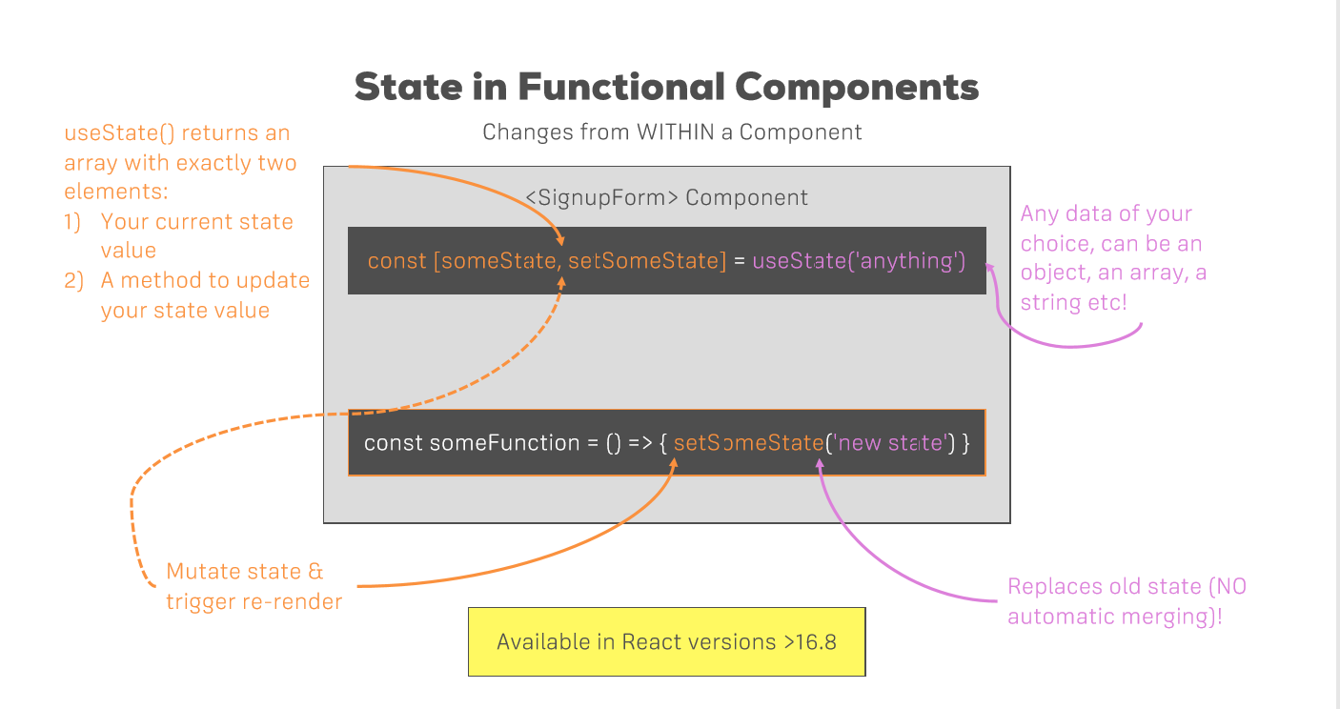

Slide 5
Stateless vs Stateful Components
Stateful component - manages state, using useState hook or a class-based approach.
Stateless Component – without internal state management.
good practice to create as many of these stateless, dumb ,presentational components
Makes our app easier to maintain and manage.

Slide 6
Passing Method References Between Components
By passing reference to the handler as a property to our component.
We can pass method also as props, in another components which don’t have direct access to states.
Example: App.js
<Person click={this.switchNameHandler} >
</Person>
In Person.js:
<p onClick={props.click}>React App</p>

Slide 7
Passing Method References Between Components
Passing Parameter to function:
e.g.: switchNameHandler(newName)
Two ways to pass data to a function with parameter.
1. bind { this.switchNameHandler.bind(this,’Test’) }
2. Arrow function {()=> this.switchNameHandler(‘Test’)}

Slide 8


